Slide 1
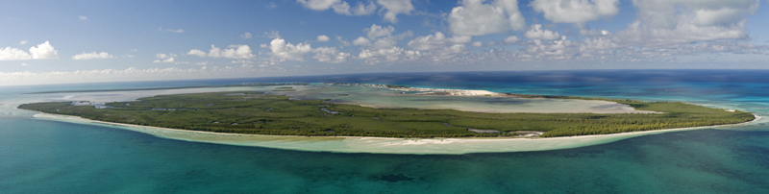






Coastal Vulnerability Model:
Mapping the Coastal Protection Benefits
Provided by the Natural Environment
Greg Guannel, K. Arkema, M. Papenfus, G. Verutes,
J. Bernhardt, A. Guerry, C.-K. Kim, M. Ruckelshaus, and J. Toft
fabiencousteau.org

Slide 2
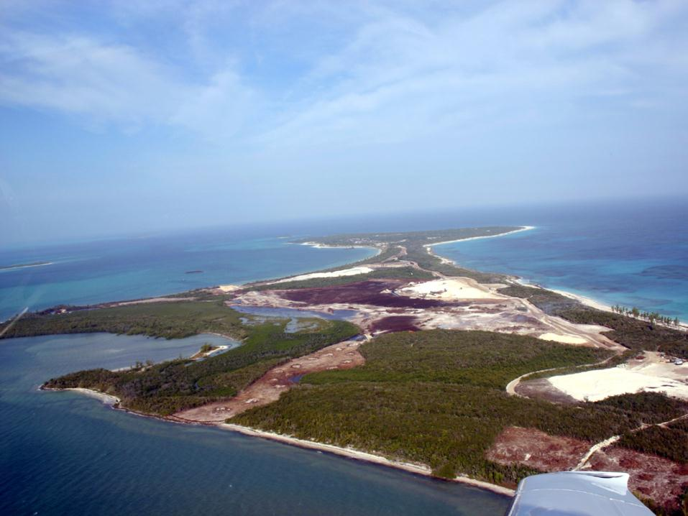
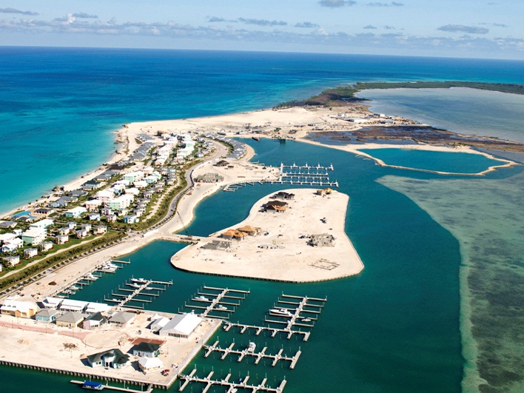
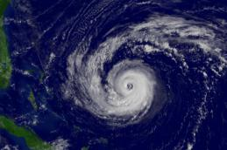
Wave, Wind
Geomorphology, Relief
Storm Surge
Natural Habitats
NOAA
SaveGuanaCayReef

Slide 3

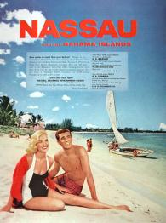
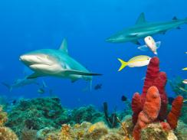
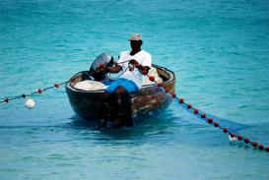
adclassix.com
Wave, Wind
jimmymacofphoenix.com
Geomorphology, Relief
Storm Surge
Marine InVEST
Natural Habitats
NOAA
SaveGuanaCayReef

Slide 4
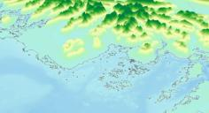
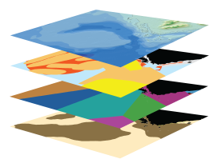
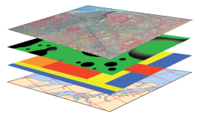
Input Data (reflect scenarios)
Marine InVEST Models
Model Outputs
(ecosystem services & values)
ECOSYSTEM SERVICES
VALUATION
Carbon
Carbon Sequestration
Value of carbon sequestered
TERRESTRIAL SYSTEMS
Wave Energy
Wave
Energy
Value of captured wave energy
BIO-PHYSICAL
Bathymetry & Topography
Coastal Protection
Avoided
Area
Avoided damages
Species distribution
Habitat Risk
SCENARIOS
Oceanography
Recreation
Tourism Revenue
Value of recreation
activity
Habitat type
Water Quality
Fishery
Landed
Biomass
Net present value of finfish and shellfish
SOCIO-ECONOMIC
Population density
Aquaculture
Harvested
Biomass
Visitation Rates
Aquaculture operation costs
Aesthetic Quality
Property values
Notes:
Scenarios: (management options or climate lead to changes in social- ecological system)
Bold arrows indicate models described in the paper…
Flow rate, sediment, nutrients, toxic waste and bacteria
Wastes, filtration
De facto MPA
Light attenuation, sedimentation
Water purification
Food supply (shellfish)
Beachgoing
Spawning, rearing
Wave attentuation

Slide 5
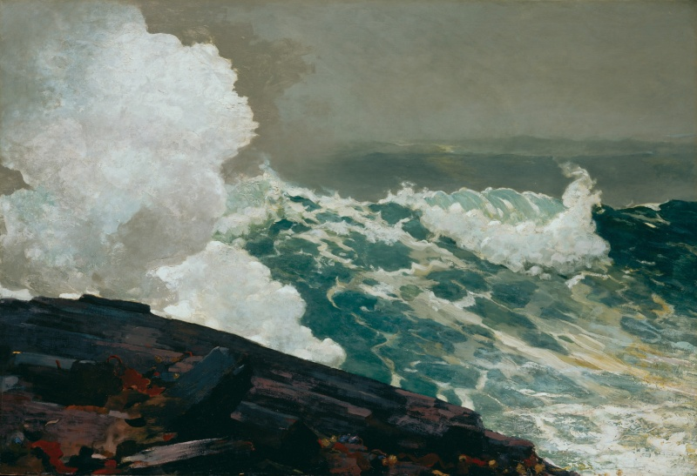
Mapping Coastal Vulnerability to Erosion and Flooding

Slide 6
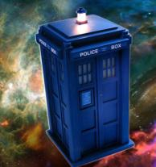
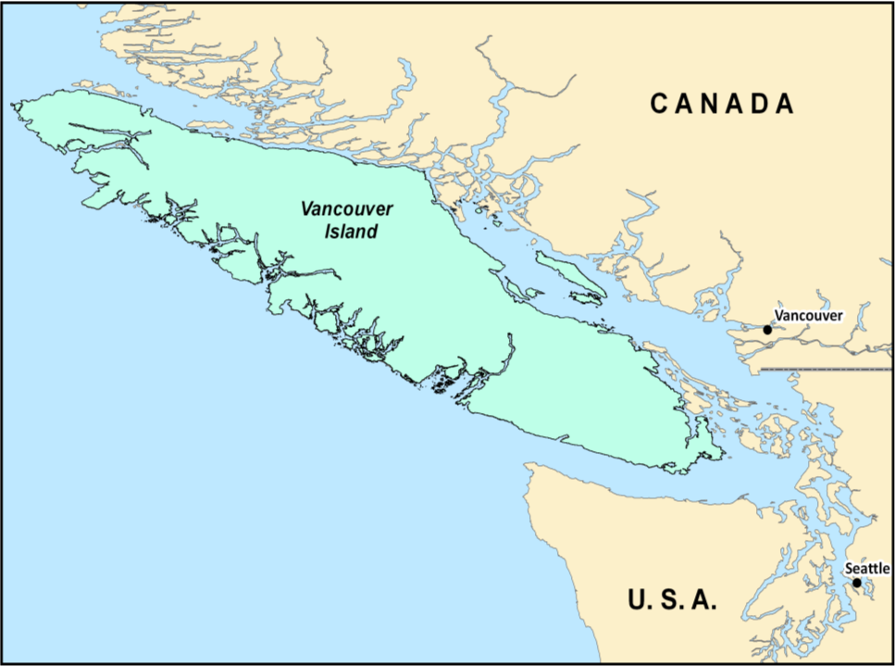

Slide 7
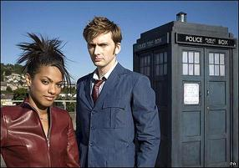
Oi!
Are there areas that are more exposed to impacts of high waves and winds than others?
Are there natural factors that can reduce these impacts?

Slide 8
Is this area vulnerable to erosion and inundation during storms?
How do changes in the natural environment affect that vulnerability?
Why does this bloody hell matter to people anyways?

Slide 9

Fascinating questions!
Let’s solve them, with the CV model!

Slide 10
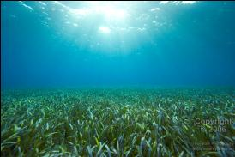
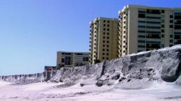
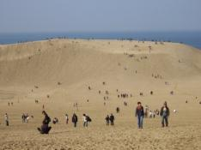
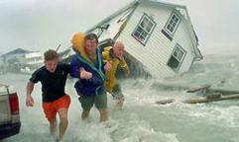
Coastal Protection Model
Two Types of Habitats
Two Types of Hazards
Living
Erosion
Non-living
Flooding

Slide 11
Coastal Protection Model
Inputs
Coastal Vulnerability Model
Know the Environment
Evaluate Scenarios
Erosion/Inundation Model

Slide 12
Coastal Vulnerability Index
RANK | Very Low | Low | Moderate | High | Very High
VARIABLE | 1 | 2 | 3 | 4 | 5
Geomorphology | Rocky; high cliffs; fiord; fiard | Medium cliff; indented coast | Low cliff; glacial drift; alluvial plain | Cobble beach; estuary; lagoon; bluff | Barrier beach; sand beach; mud flat; delta
Relief | > 90th Percentile | > 75th Percentile | Average value | < 25th Percentile | < 10th Percentile
Natural Habitats | Coral reef; mangrove; coastal forest | High dune; marsh | Low dune | Seagrass; kelp | No habitat
Sea Level Change | Net decrease |  | ±1 |  | Net rise
Wind Exposure | < 10th Percentile | < 25th Percentile | Average value | > 75th Percentile | > 90th Percentile
Wave Exposure | < 10th Percentile | < 25th Percentile | Average value | > 75th Percentile | > 90th Percentile
Surge Potential | No exposure | < 25th Percentile | Average value | > 75th Percentile | > 90th Percentile
Qualitative assessment of vulnerability based on mixture of relative and absolute ranking of variables

Slide 13
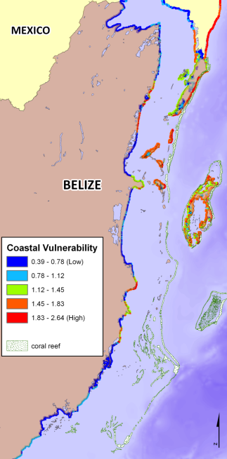
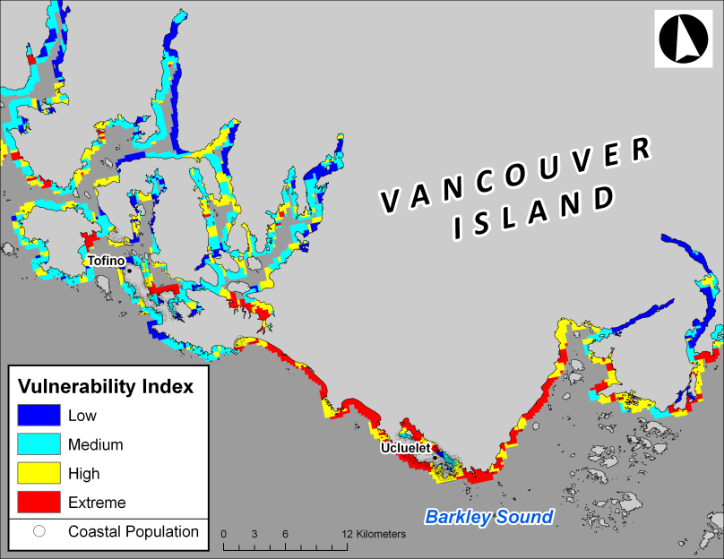
Coastal Vulnerability Outputs
Notes:
Can also subtract results to get change

Slide 14
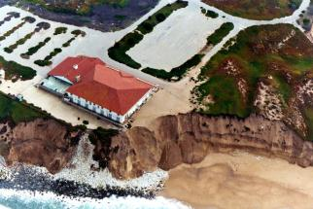
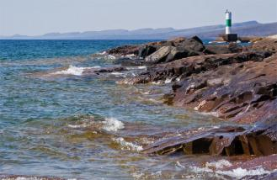
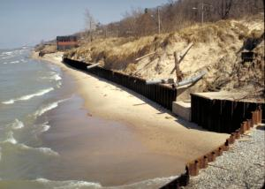
What’s in an Index?....rock
Rank | Very Low | Low | Moderate | High | Very High
Variable | 1 | 2 | 3 | 4 | 5
Geomorphology | Rocky; high cliffs; fiord; fiard | Medium cliff; indented coast | Low cliff; glacial drift; alluvial plain | Cobble beach; estuary; lagoon; bluff | Barrier beach; sand beach; mud flat; delta
Relief | > 90th Percentile | > 75th Percentile | Average value | < 25th Percentile | < 10th Percentile
Natural Habitats | Coral reef; mangrove; coastal forest | High dune; marsh | Low dune | Seagrass; kelp | No habitat
Sea Level Change | Net decrease |  | ±1 |  | Net rise
Wind Exposure | < 10th Percentile | < 25th Percentile | Average value | > 75th Percentile | > 90th Percentile
Wave Exposure | < 10th Percentile | < 25th Percentile | Average value | > 75th Percentile | > 90th Percentile
Surge Potential | No exposure | < 25th Percentile | Average value | > 75th Percentile | > 90th Percentile

Slide 15
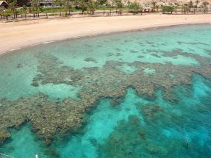
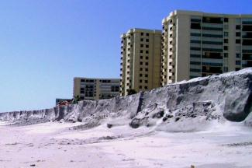
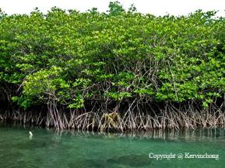
Living Things! (mostly)
Rank | Very Low | Low | Moderate | High | Very High
Variable | 1 | 2 | 3 | 4 | 5
Geomorphology | Rocky; high cliffs; fiord; fiard | Medium cliff; indented coast | Low cliff; glacial drift; alluvial plain | Cobble beach; estuary; lagoon; bluff | Barrier beach; sand beach; mud flat; delta
Relief | > 90th Percentile | > 75th Percentile | Average value | < 25th Percentile | < 10th Percentile
Natural Habitats | Coral reef; mangrove; coastal forest | High dune; marsh | Low dune | Seagrass; kelp | No habitat
Sea Level Change | Net decrease |  | ±1 |  | Net rise
Wind Exposure | < 10th Percentile | < 25th Percentile | Average value | > 75th Percentile | > 90th Percentile
Wave Exposure | < 10th Percentile | < 25th Percentile | Average value | > 75th Percentile | > 90th Percentile
Surge Potential | No exposure | < 25th Percentile | Average value | > 75th Percentile | > 90th Percentile

Slide 16
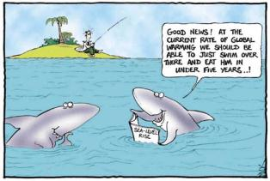
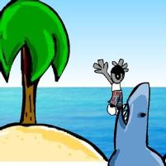
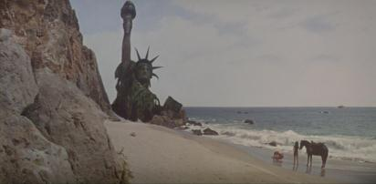
Lots of Water…AND LAND!
Rank | Very Low | Low | Moderate | High | Very High
Variable | 1 | 2 | 3 | 4 | 5
Geomorphology | Rocky; high cliffs; fiord; fiard | Medium cliff; indented coast | Low cliff; glacial drift; alluvial plain | Cobble beach; estuary; lagoon; bluff | Barrier beach; sand beach; mud flat; delta
Relief | > 90th Percentile | > 75th Percentile | Average value | < 25th Percentile | < 10th Percentile
Natural Habitats | Coral reef; mangrove; coastal forest | High dune; marsh | Low dune | Seagrass; kelp | No habitat
Sea Level Change | Net decrease |  | ±1 |  | Net rise
Wind Exposure | < 10th Percentile | < 25th Percentile | Average value | > 75th Percentile | > 90th Percentile
Wave Exposure | < 10th Percentile | < 25th Percentile | Average value | > 75th Percentile | > 90th Percentile
Surge Potential | No exposure | < 25th Percentile | Average value | > 75th Percentile | > 90th Percentile

Slide 17
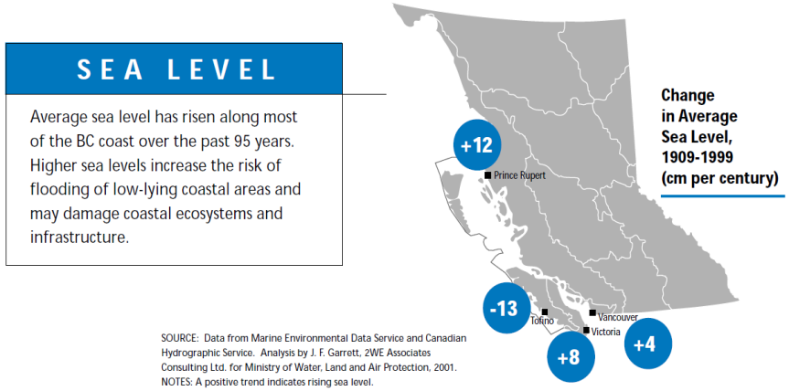
Relative Sea Level Change
British Columbia. Ministry of Water, Land and Air Protection
Need to take land movement into account!

Slide 18
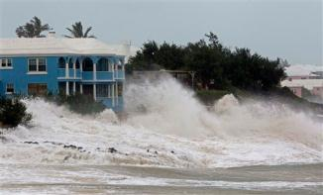
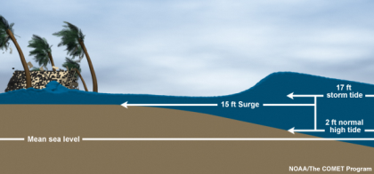
Coastal Exposure Index?
Rank | Very Low | Low | Moderate | High | Very High
Variable | 1 | 2 | 3 | 4 | 5
Geomorphology | Rocky; high cliffs; fiord; fiard | Medium cliff; indented coast | Low cliff; glacial drift; alluvial plain | Cobble beach; estuary; lagoon; bluff | Barrier beach; sand beach; mud flat; delta
Relief | > 90th Percentile | > 75th Percentile | Average value | < 25th Percentile | < 10th Percentile
Natural Habitats | Coral reef; mangrove; coastal forest | High dune; marsh | Low dune | Seagrass; kelp | No habitat
Sea Level Change | Net decrease |  | ±1 |  | Net rise
Wind Exposure | < 10th Percentile | < 25th Percentile | Average value | > 75th Percentile | > 90th Percentile
Wave Exposure | < 10th Percentile | < 25th Percentile | Average value | > 75th Percentile | > 90th Percentile
Surge Potential | No exposure | < 25th Percentile | Average value | > 75th Percentile | > 90th Percentile
Wind

Slide 19
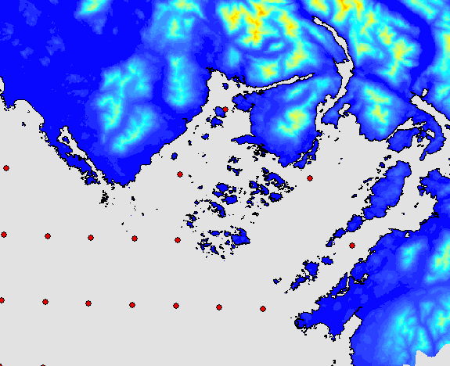
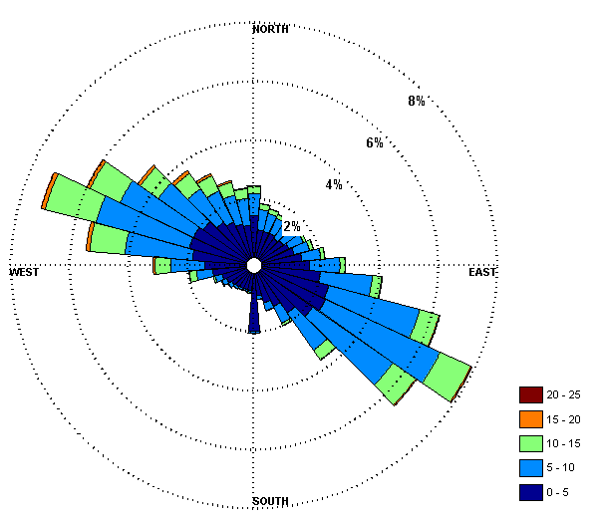
Wind Exposure
U

Slide 20
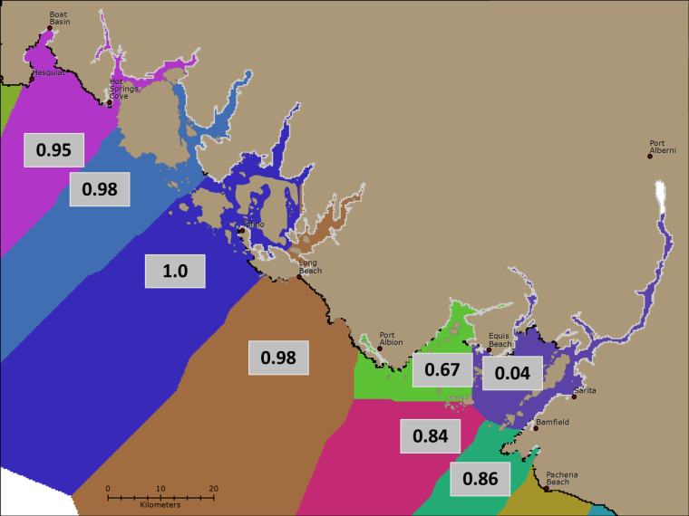
Wave Exposure
U
Exposed shorelines: ocean waves
Sheltered shorelines: locally-generated waves

Slide 21
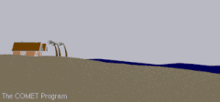
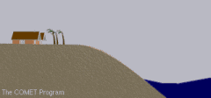
Flooding!
Rank | Very Low | Low | Moderate | High | Very High
Variable | 1 | 2 | 3 | 4 | 5
Geomorphology | Rocky; high cliffs; fiord; fiard | Medium cliff; indented coast | Low cliff; glacial drift; alluvial plain | Cobble beach; estuary; lagoon; bluff | Barrier beach; sand beach; mud flat; delta
Relief | > 90th Percentile | > 75th Percentile | Average value | < 25th Percentile | < 10th Percentile
Natural Habitats | Coral reef; mangrove; coastal forest | High dune; marsh | Low dune | Seagrass; kelp | No habitat
Sea Level Change | Net decrease |  | ±1 |  | Net rise
Wind Exposure | < 10th Percentile | < 25th Percentile | Average value | > 75th Percentile | > 90th Percentile
Wave Exposure | < 10th Percentile | < 25th Percentile | Average value | > 75th Percentile | > 90th Percentile
Surge Potential | No exposure | < 25th Percentile | Average value | > 75th Percentile | > 90th Percentile

Slide 22
Coastal Vulnerability Index
RANK | Very Low | Low | Moderate | High | Very High
VARIABLE | 1 | 2 | 3 | 4 | 5
Geomorphology | Rocky; high cliffs; fiord; fiard | Medium cliff; indented coast | Low cliff; glacial drift; alluvial plain | Cobble beach; estuary; lagoon; bluff | Barrier beach; sand beach; mud flat; delta
Relief | > 90th Percentile | > 75th Percentile | Average value | < 25th Percentile | < 10th Percentile
Natural Habitats | Coral reef; mangrove; coastal forest | High dune; marsh | Low dune | Seagrass; kelp | No habitat
Sea Level Change | Net decrease |  | ±1 |  | Net rise
Wind Exposure | < 10th Percentile | < 25th Percentile | Average value | > 75th Percentile | > 90th Percentile
Wave Exposure | < 10th Percentile | < 25th Percentile | Average value | > 75th Percentile | > 90th Percentile
Surge Potential | No exposure | < 25th Percentile | Average value | > 75th Percentile | > 90th Percentile
Qualitative assessment of vulnerability based on mixture of relative and absolute ranking of variables

Slide 23
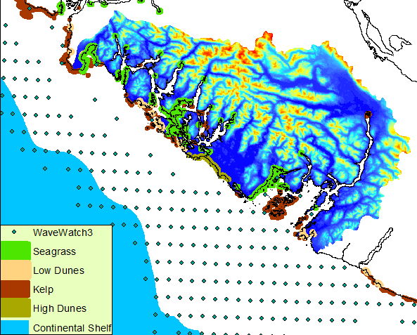
Example Inputs

Slide 24
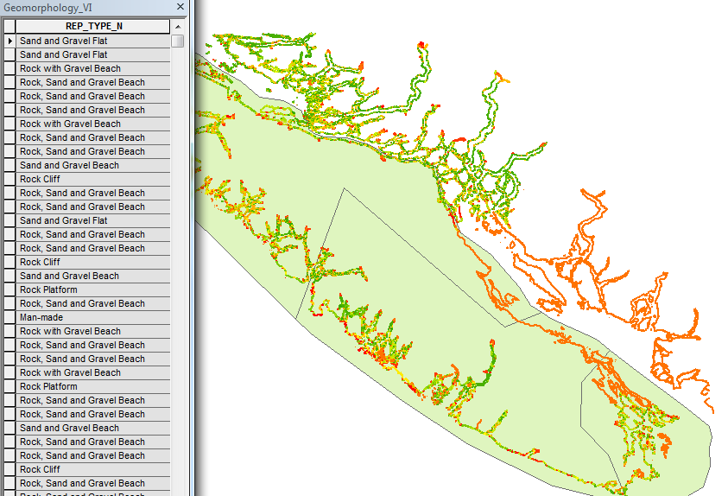
Example Inputs

Slide 25
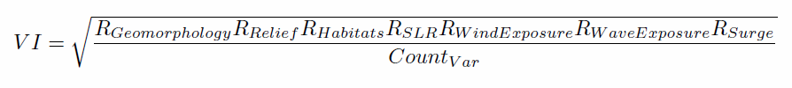

Vulnerability Index Output
Notes:
Assumptions:
most important factors affecting erosian = geomorphology, natural habitats and wave height/period
most important factors affecting inundation = relief, natural habitats, sea-level rise, wind exposure, and surge potential
Can create your own index using “Field Calculator”
25

Slide 26
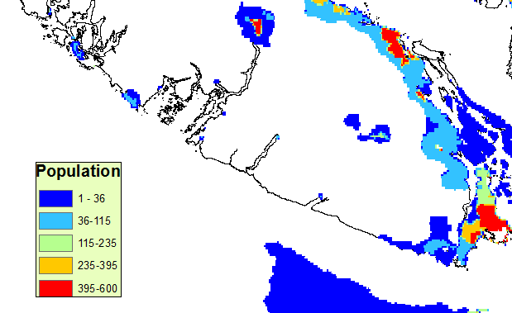
Oh! And What Did Martha Say?
Why does this bloody hell matter to people anyways?

Slide 27
Limitations and Assumptions
- Complex coastal processes summarized by 7 variables
Screening Tool
- No prediction of shoreline change
Qualitative Tool
- Site-specific sediment transport patterns ignored
General Tool
Notes:
27

Slide 28

Application

Slide 29
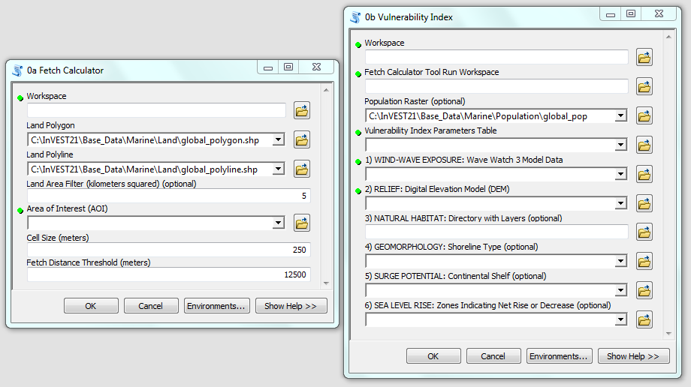
Model Steps
Run Fetch Calculator
Fetch distances
Exposed/Non-Exposed Shorelines
Run Vulnerability Index
Notes:
Review results from Fetch Calc before running Vulnerability Index…
29

Slide 30
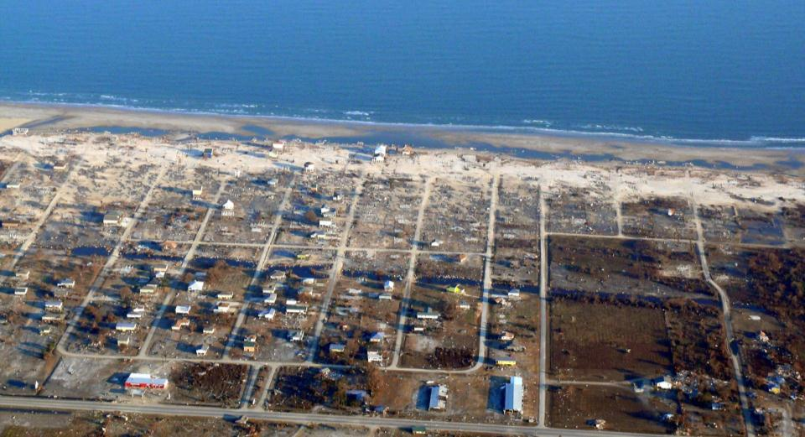
Erosion/Inundation Model
Steve@Flickr
Notes:
Overall – process of attenuation – get to service
Then – need information on xyz

Slide 31
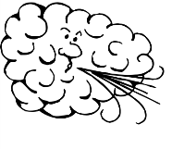
Erosion/Inundation Model
Notes:
Overall – process of attenuation – get to service
Then – need information on xyz

Slide 32
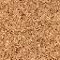
Erosion/Inundation Model
Can treat effects of coral reefs, mangroves, marshes, seagrass beds, oyster reefs and sand dunes
Notes:
Overall – process of attenuation – get to service
Then – need information on xyz

Slide 33
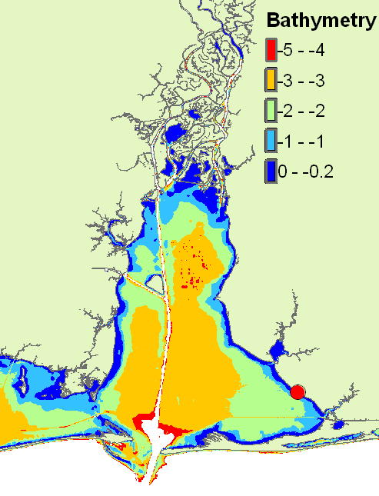
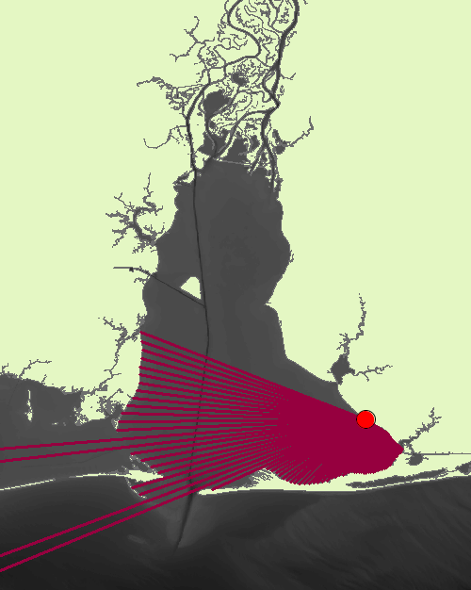
Example Outputs: Oyster Reefs
Bathymetry Cross-Section
Fetch Distances

Slide 34
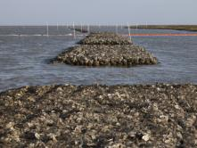
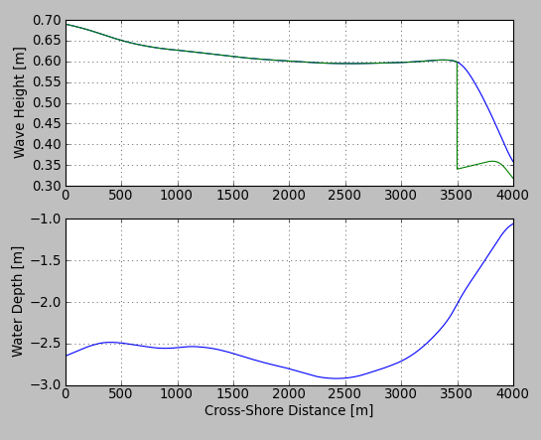
Example Outputs: Oyster Reefs
Design Wave
H=1m; T=5s

Slide 35
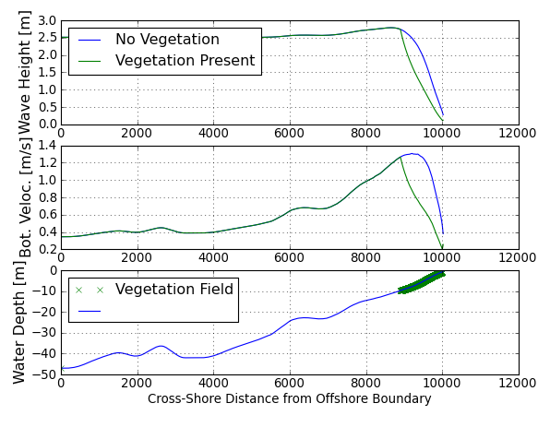

Example Outputs: Seagrass Beds

Slide 36

Let’s Run the Model!

Slide 37

Model Interface

Slide 38

Parameters Table

Slide 39
Geomorphology
Very Low | Low | Moderate | High | Very High
1 | 2 | 3 | 4 | 5
Rocky; high cliffs; fiord; fiard | Medium cliff; indented coast | Low cliff; glacial drift; alluvial plain | Cobble beach; estuary; lagoon; bluff | Barrier beach; sand beach; mud flat; delta
How to Represent Structures?

Slide 40

Natural Habitats
Very Low | Low | Moderate | High | Very High
1 | 2 | 3 | 4 | 5
Coral reef; mangrove; coastal forest | High dune; marsh | Low dune | Seagrass; kelp | No habitat
How/Why remove habitats in CV run?

Slide 41

Wind and Wave Data

Slide 42


Model Outputs
Vulnerability Index
Erosion Index
Inundation Index
Notes:
Assumptions:
most important factors affecting erosian = geomorphology, natural habitats and wave height/period
most important factors affecting inundation = relief, natural habitats, sea-level rise, wind exposure, and surge potential
Can create your own index using “Field Calculator”
42

Slide 43

Update – Ranking Natural Habitats
Current Ranking
Rank | 1 | 2 | 3 | 4 | 5
Natural Habitats | Coral reef; mangrove; | High dune; marsh | Low dune coastal forest | Seagrass; kelp | No habitat

Slide 44

Update – Ranking Natural Habitats
$$R_{Hab}=6−\frac{\sqrt{{\left(2\max\left(R_{k}\right)\right)}^{2}+\left(\sum_{k=1}^{n}{R_{k}^{2}}−\max{{\left(R_{k}\right)}^{2}}\right)}}{2}$$
More habitats = more protection!

Slide 45



Wave Exposure – New Approach
$$E_{w}=max (E_{w}^{o}, E_{w}^{l})$$

